Slide 1
Pizza Sales Report
File created on: 11/21/2024 7:12:26 PM

Slide 2
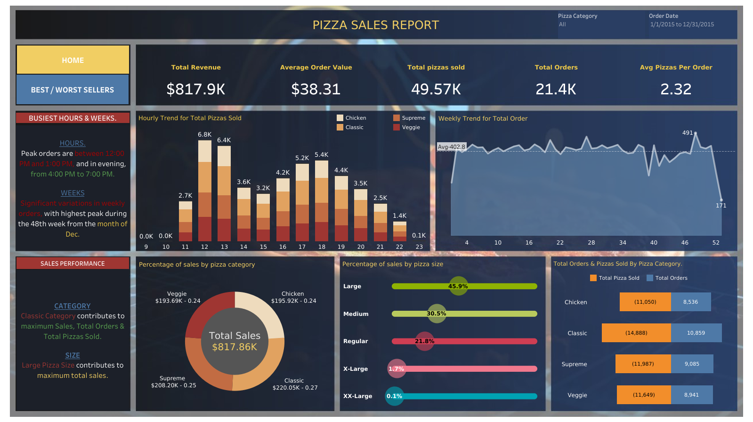

Slide 3
